Slide 1
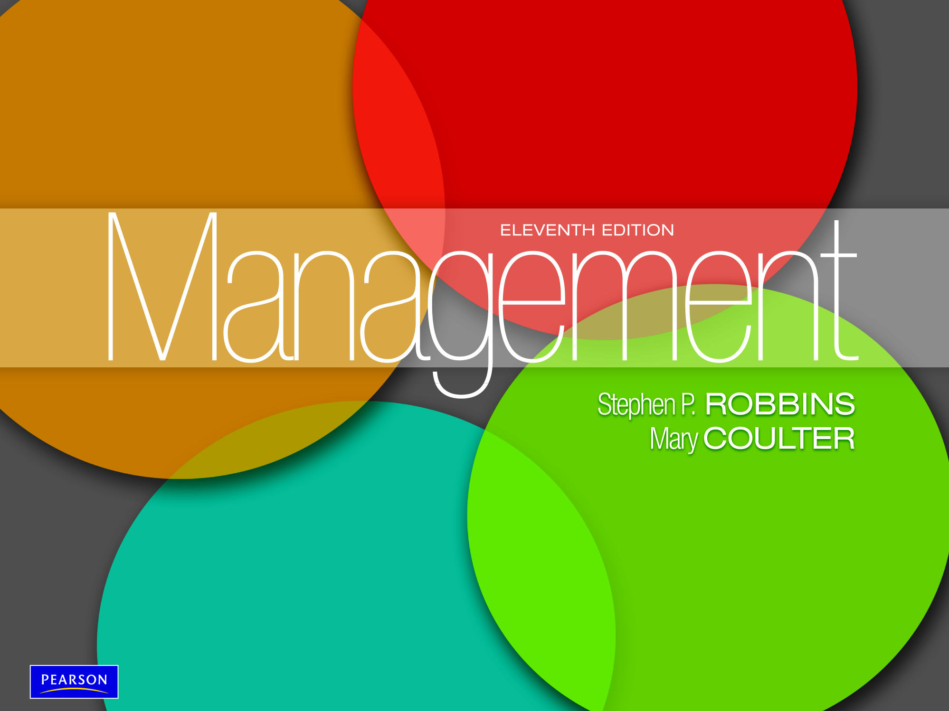

Slide 2
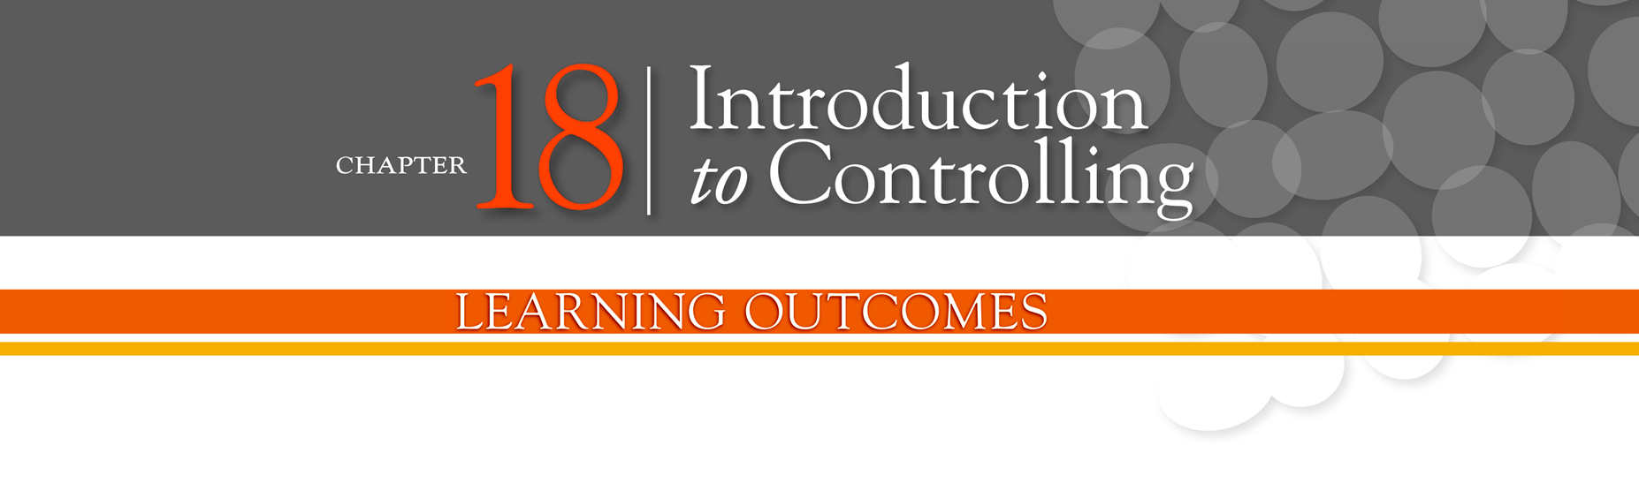
Explain the nature and importance of control
Describe the three steps in the control process
Explain how organizational performance is measured
Describe tools used to measure organizational
performance
Discuss contemporary issues in control

Slide 3
What Is Control?
Controlling - the process of monitoring, comparing, and correcting work performance.
The Purpose of Control
To ensure that activities are completed in ways that lead to the accomplishment of organizational goals.

Slide 4
Why Is Control Important?
As the final link in management functions:
Planning
Controls let managers know whether their goals and plans are on target and what future actions to take.
Empowering employees
Control systems provide managers with information and feedback on employee performance.
Protecting the workplace
Controls enhance physical security and help minimize workplace disruptions.

Slide 5
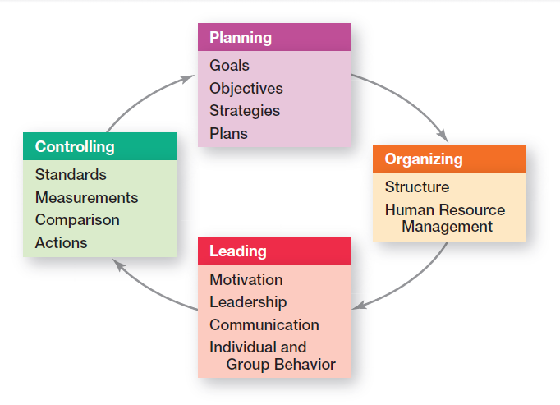
Exhibit 18-1: Planning-Controlling Link
Notes:
As the final step in the management process, controlling provides the critical link back to planning (see Exhibit 18-1). If managers didn’t control, they’d have no way of knowing whether their goals and plans were being achieved and what future actions to take.

Slide 6
What is the Control Process?
Control process - a three-step process of measuring actual performance, comparing actual performance against a standard, and taking managerial action to correct deviations or inadequate standards.

Slide 7
The Control Process
The Process of Control
Measuring actual performance
Comparing actual performance against a standard
Taking action to correct deviations or inadequate standards

Slide 8
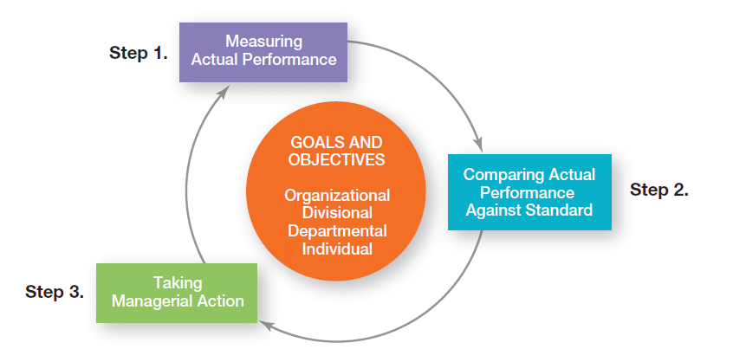
Exhibit 18-2: The Control Process
Notes:
The control process is a three-step process of measuring actual performance, comparing actual performance against a standard, and taking managerial action to correct deviations or to address inadequate standards. (See Exhibit 18-2.)

Slide 9
Measuring: How and What We Measure
Sources of Information (How)
Personal observation
Statistical reports
Oral reports
Written reports
Control Criteria (What)
Employees
Satisfaction
Turnover
Absenteeism
Budgets
Costs
Output
Sales

Slide 10
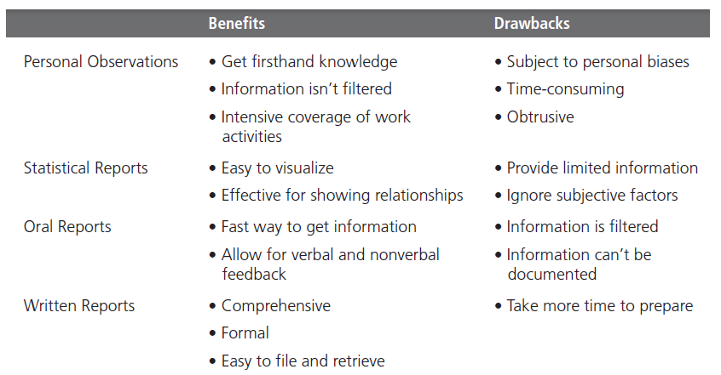
Exhibit 18-3: Sources of Information for Measuring Performance
Notes:
Four approaches used by managers to measure and report actual performance are personal observations, statistical reports, oral reports, and written reports. Exhibit 18-3 summarizes the advantages and drawbacks of each approach. Most managers use a combination of these approaches.

Slide 11
Comparing Actual Performance Against the Standard
Determining the degree of variation between actual performance and the standard
Range of variation - the acceptable parameters of variance between actual performance and the standard.

Slide 12
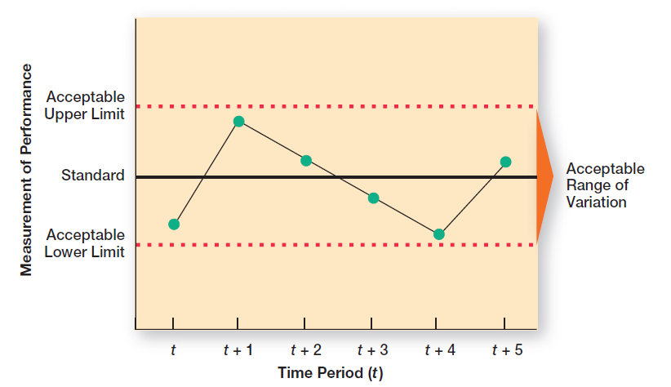
Exhibit 18-4: Acceptable Range of Variation
Notes:
The comparing step determines the variation between actual performance and the standard. Although some variation in performance can be expected in all activities, it’s critical to determine an acceptable range of variation (see Exhibit 18-4). Deviations outside this range need attention.

Slide 13
Taking Managerial Action
Immediate corrective action - corrective action that corrects problems at once in order to get performance back on track.
Basic corrective action - corrective action that looks at how and why performance deviated before correcting the source of deviation.

Slide 14
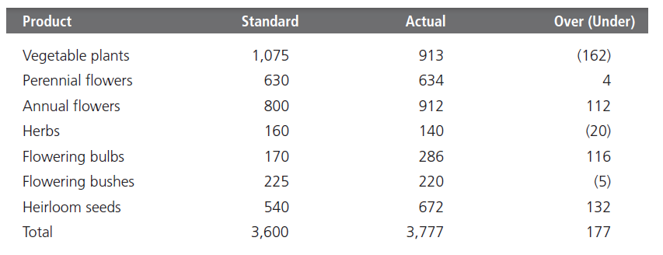
Exhibit 18-5: Green Earth Gardening Supply — June Sales
Notes:
Exhibit 18-5 displays both the sales goals (standard) and actual sales figures for the month
of June.

Slide 15
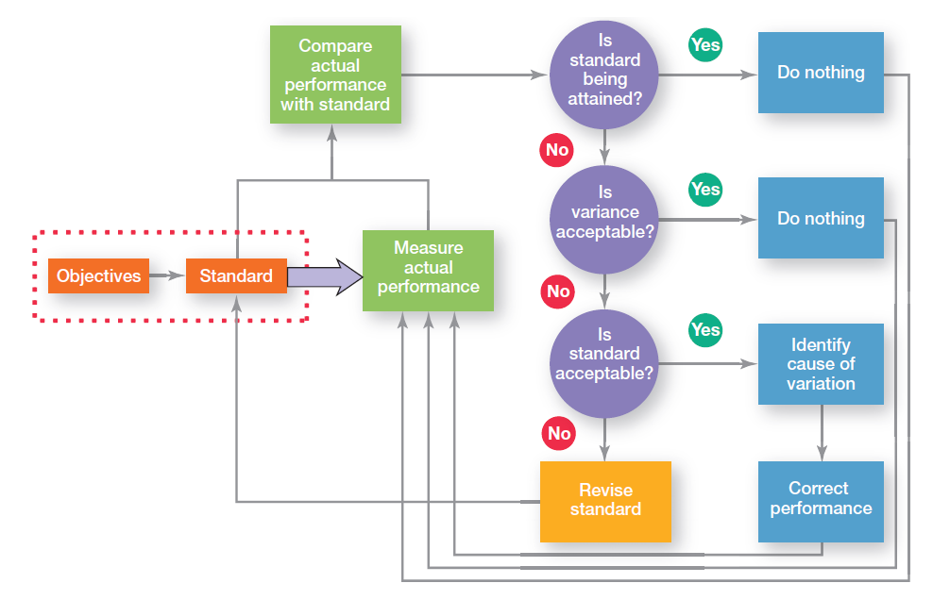
Exhibit 18-6: Managerial Decisions in the Control Process
Notes:
Exhibit 18-6 summarizes the decisions a manager makes in controlling. The standards are goals that were developed during the planning process.

Slide 16
What Is Organizational Performance?
Performance - the end result of an activity.
Organizational performance - the accumulated results of all the organization’s work activities.

Slide 17
Measures of Organizational Performance
Productivity - the amount of goods or services produced divided by the inputs needed to generate that output.
Organizational effectiveness - a measure of how appropriate organizational goals are and how well those goals are being met.

Slide 18
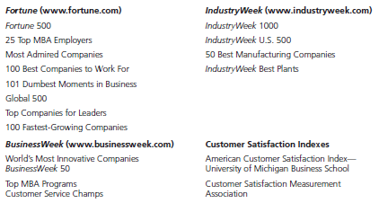
Exhibit 18-7: Popular Industry and Company Rankings
Notes:
Rankings are a popular way for managers to measure their organization’s performance. As Exhibit 18-7 shows, there’s not a shortage of these rankings.

Slide 19
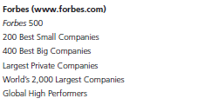
Exhibit 18-7: Popular Industry and Company Rankings (cont.)

Slide 20
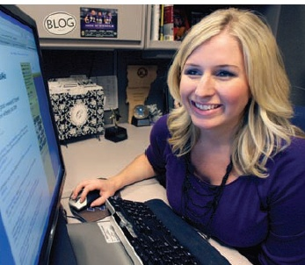
Types of Control
Feed forward control - control that takes place before a work activity is done.
Concurrent control - control that takes place while a work activity is in progress.

Slide 21
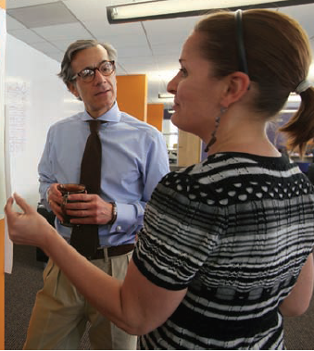
Types of Control (cont.)
Management by walking around - a term used to describe when a manager is out in the work area interacting directly with employees.
Feedback control - control that takes place after a work activity is done.

Slide 22
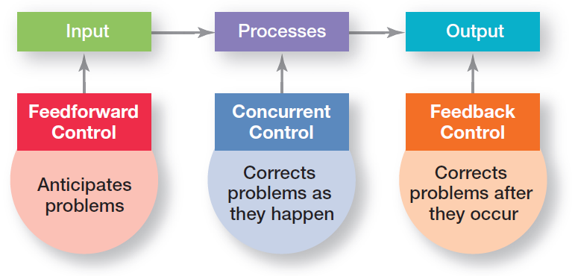
Exhibit 18-8: Types of Control
Notes:
Managers can implement controls before an activity begins, during the time the activity is going on, and after the activity has been completed. The first type is called feedforward control; the second, concurrent control; and the last, feedback control (see Exhibit 18-8).

Slide 23
Financial Controls
Traditional Controls
Ratio analysis
Liquidity
Leverage
Activity
Profitability
Budget Analysis
Quantitative standards
Deviations

Slide 24
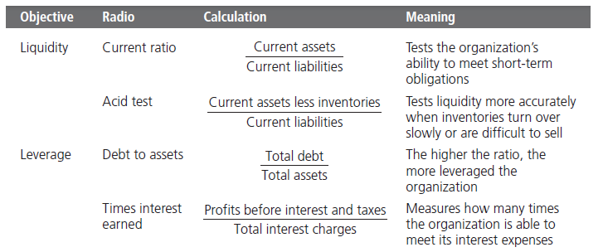
Exhibit 18-9: Popular Financial Ratios
Notes:
Exhibit 18-9 summarizes some of the most popular financial ratios.

Slide 25
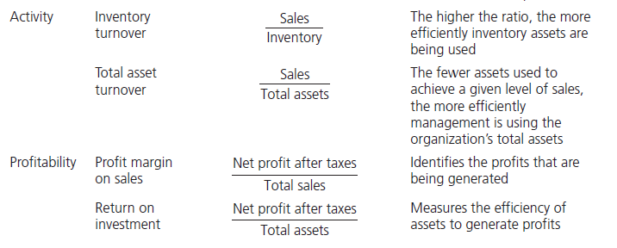
Exhibit 18-9: Popular Financial Ratios (cont.)

Slide 26
What is the Balanced Scorecard?
Balanced scorecard - a performance measurement tool that examines more than just the financial perspective.
Measures a company’s performance in four areas:
Financial
Customer
Internal processes
People/innovation/growth assets

Slide 27
Information Controls
Management information system (MIS) - a system used to provide management with needed information on a regular basis.
Data - an unorganized collection of raw, unanalyzed facts (e.g., an unsorted list of customer names).
Information - data that has been analyzed and organized such that it has value and relevance to managers.

Slide 28
Benchmarking of Best Practices
Benchmarking - the search for the best practices among competitors or non-competitors that lead to their superior performance.
Benchmark - the standard of excellence to measure and compare against.

Slide 29
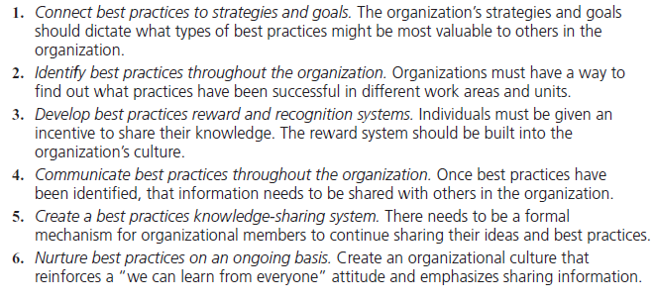
Exhibit 18-10: Suggestions for Internal Benchmarking
Notes:
Exhibit 18-10 provides some suggestions for internal benchmarking.

Slide 30
Workplace Concerns
Employee theft - any unauthorized taking of company property by employees for their personal use.

Slide 31
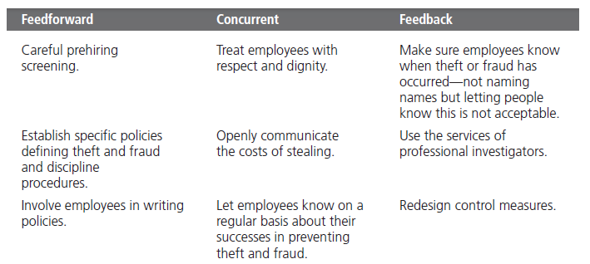
Exhibit 18-11: Controlling Employee Theft
Notes:
The concept of feed forward, concurrent, and feedback control is useful for identifying measures to deter or reduce employee theft. Exhibit 18-11 summarizes several possible managerial actions.

Slide 32
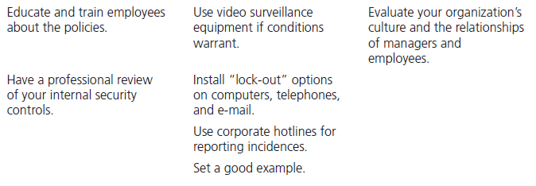
Exhibit 18-11: Controlling Employee Theft (cont.)

Slide 33
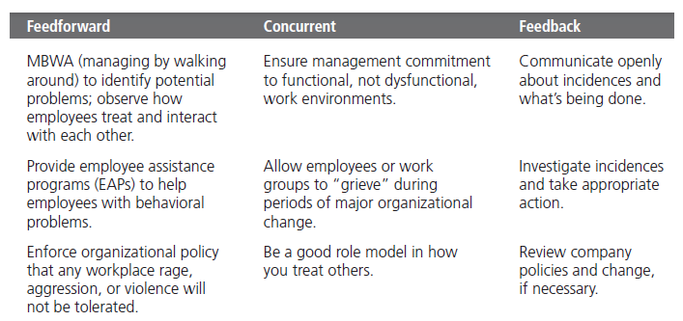
Exhibit 18-12: Controlling Workplace Violence
Notes:
What can managers do to deter or reduce possible workplace violence? Once again, the concept of feed forward, concurrent, and feedback control can help identify actions that managers can take. Exhibit 18-12 summarizes several suggestions.

Slide 34
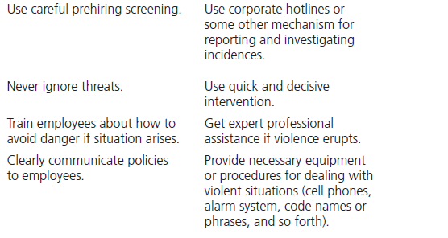
Exhibit 18-12: Controlling Workplace Violence (cont.)

Slide 35
Customer Interactions
Service profit chain - the service sequence from employees to customers to profit.
Corporate governance - the system used to govern a corporation so that the interests of corporate owners are protected.

Slide 36
Terms to Know
controlling
market control
bureaucratic control
control process
range of variation
immediate corrective action
basic corrective action
performance
organizational performance
productivity
organizational effectiveness
feed forward control
concurrent control
management by walking around
feedback control
economic value added (EVA)
market value added (MVA)

